Slide 1

18-19 Jan 2020
HACKATHON
TEAM NAME:DELTA
TEAM CAPTAIN:PRANAV VERMA
TEAM MEMBERS
PRANAV VERMA
SAGAR SONEJA
KHUSHI JAIN
SHIVALIKA DEVI
VENUE : ARYA COLLEGE OF ENGINEERING AND IT

Slide 2
INTRODUCTION
Everything we love about civilization is a product of intelligence, so amplifying our human intelligence with artificial intelligence has the potential of helping civilization flourish like never before – as long as we manage to keep the technology useful.
This generation is progressing in the field of technology at a pace which seems really impressive.
We all know self-driving cars is one of the hottest areas of research and business for the tech giants. What seemed like a science-fiction, a few years ago, now seems more like something which is soon to become a part and parcel of life. The reason, I am saying “soon to be” is because of the fact that even though companies like Tesla, Nissan, Cadillac do have self-driving car assistance software, but, they still require a human to keep an eye on the road and take control when needed. However, it is fascinating to see how far we have come in terms of innovation and how fast technology is advancing. So much so, that now, with the help of basic deep learning, neural network magic, we can build our own pipeline for autonomous driving!

Slide 3
GENERAL IDEA
We are trying to develop a technology which will be totally autonomous for self driving cars to go from one designation to another by teaching the technology with Machine Learning, Data Science And Artificial Intelligence. This technology can be implemented in other transportation services to make a fast, reliable, efficient and accident free world.
This car can be used for delivering.

Slide 4
TECHNOLOGIES USED
MACHINE LEARNING
DATA SCIENCE
ARTIFICIAL INTELLIGENCE
GOOGLE COLAB TO TRAIN OUR NETWORK. IT PROVIDES GPU AND TPU.
WHAT WE SHOULD KNOW
PYTHON
STATISTICS
DATA VISUALISATION

Slide 5
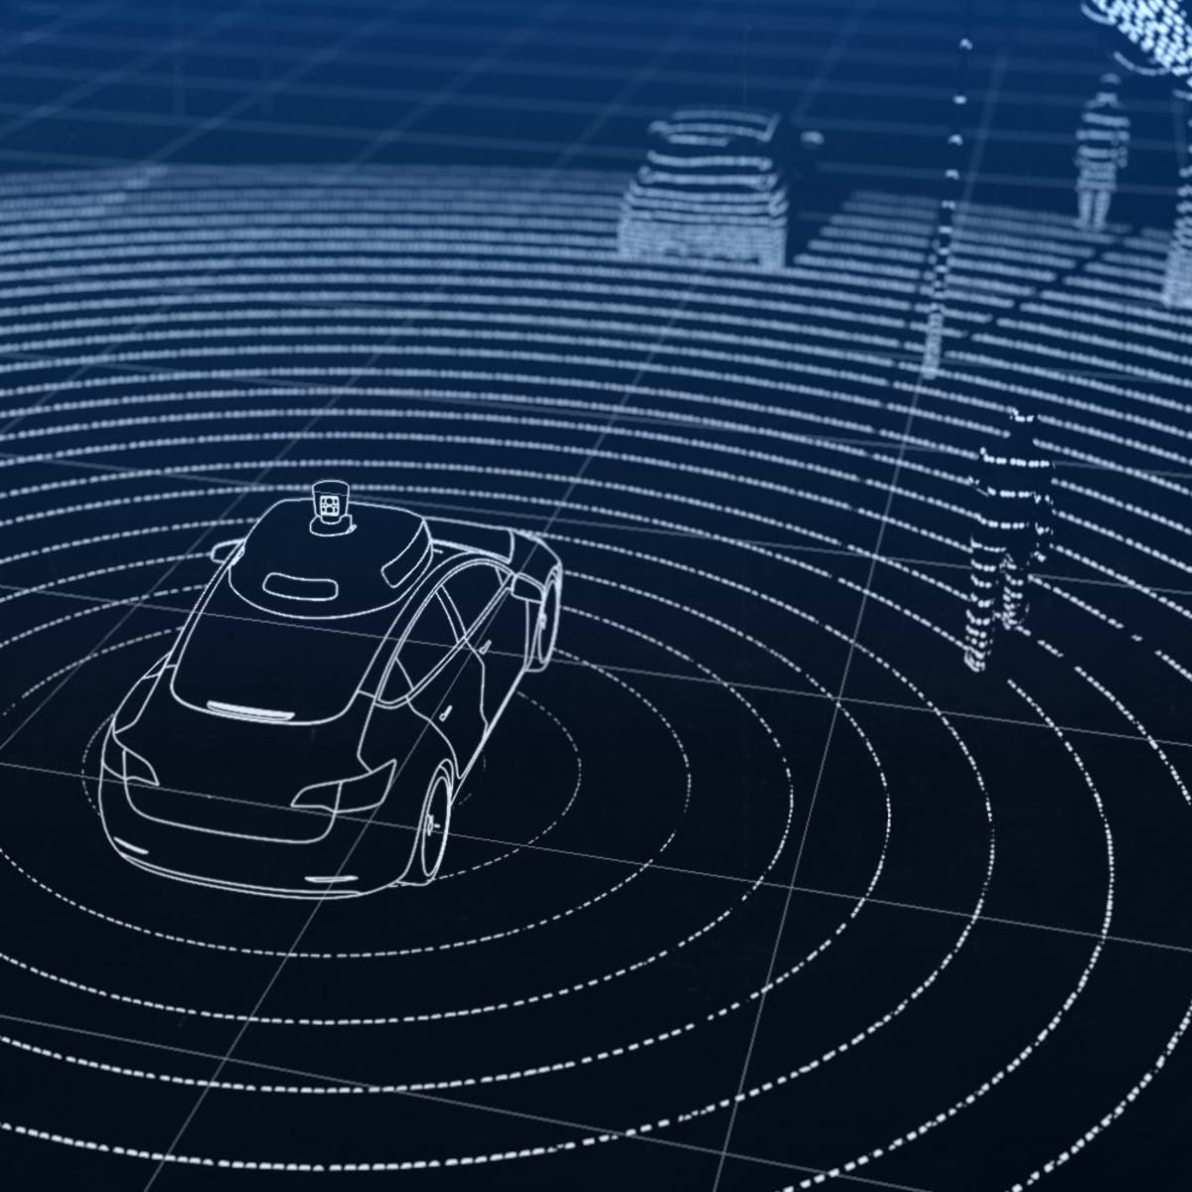
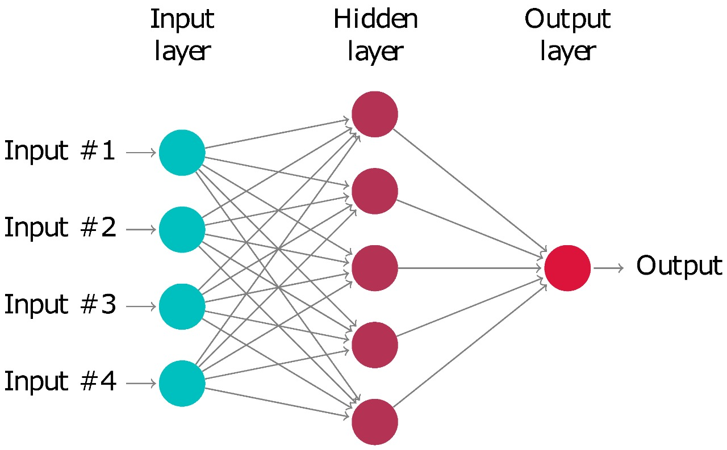
Data Collection
Neural Networks

Slide 6





LIBRARIES
OPEN CV(For detection of colors and analyse images and videos)
TENSOR FLOW(For ML and AI used developed by google)
KERAS ( Recognizing something when taught)
NUMPY (For mathematical calculations.
PANDAS (To analyze the dataset and make important data out of it)

Slide 7
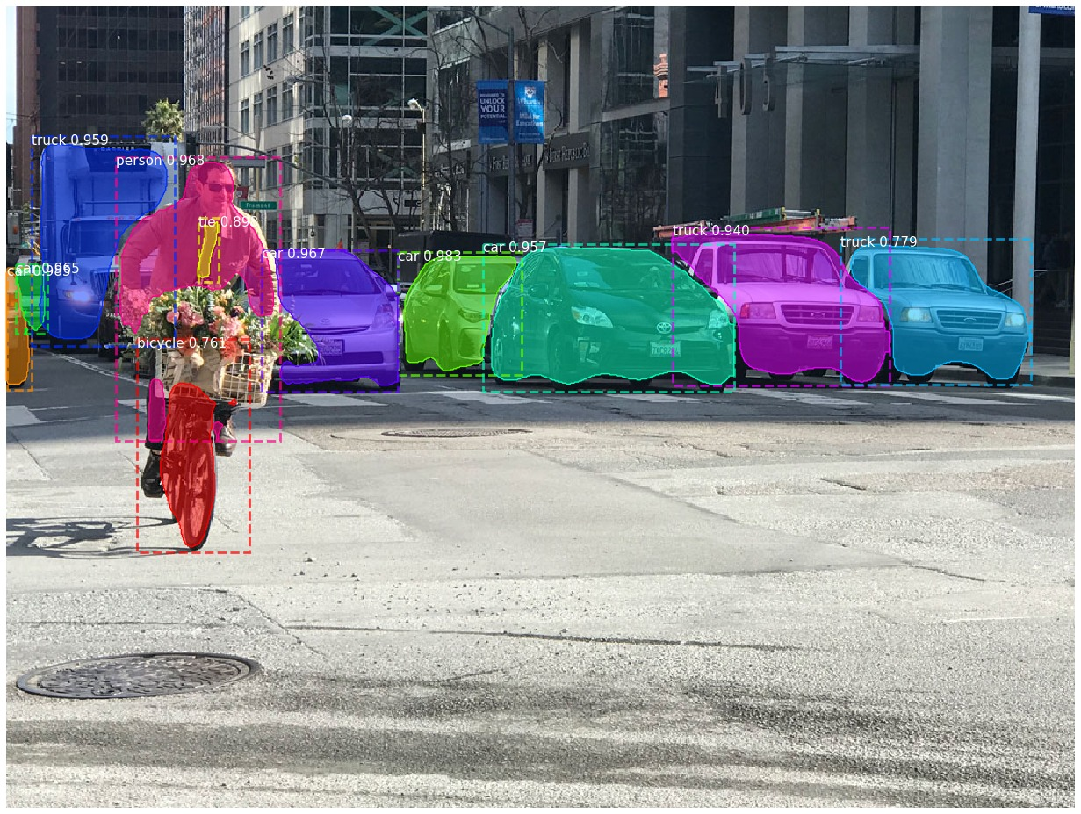
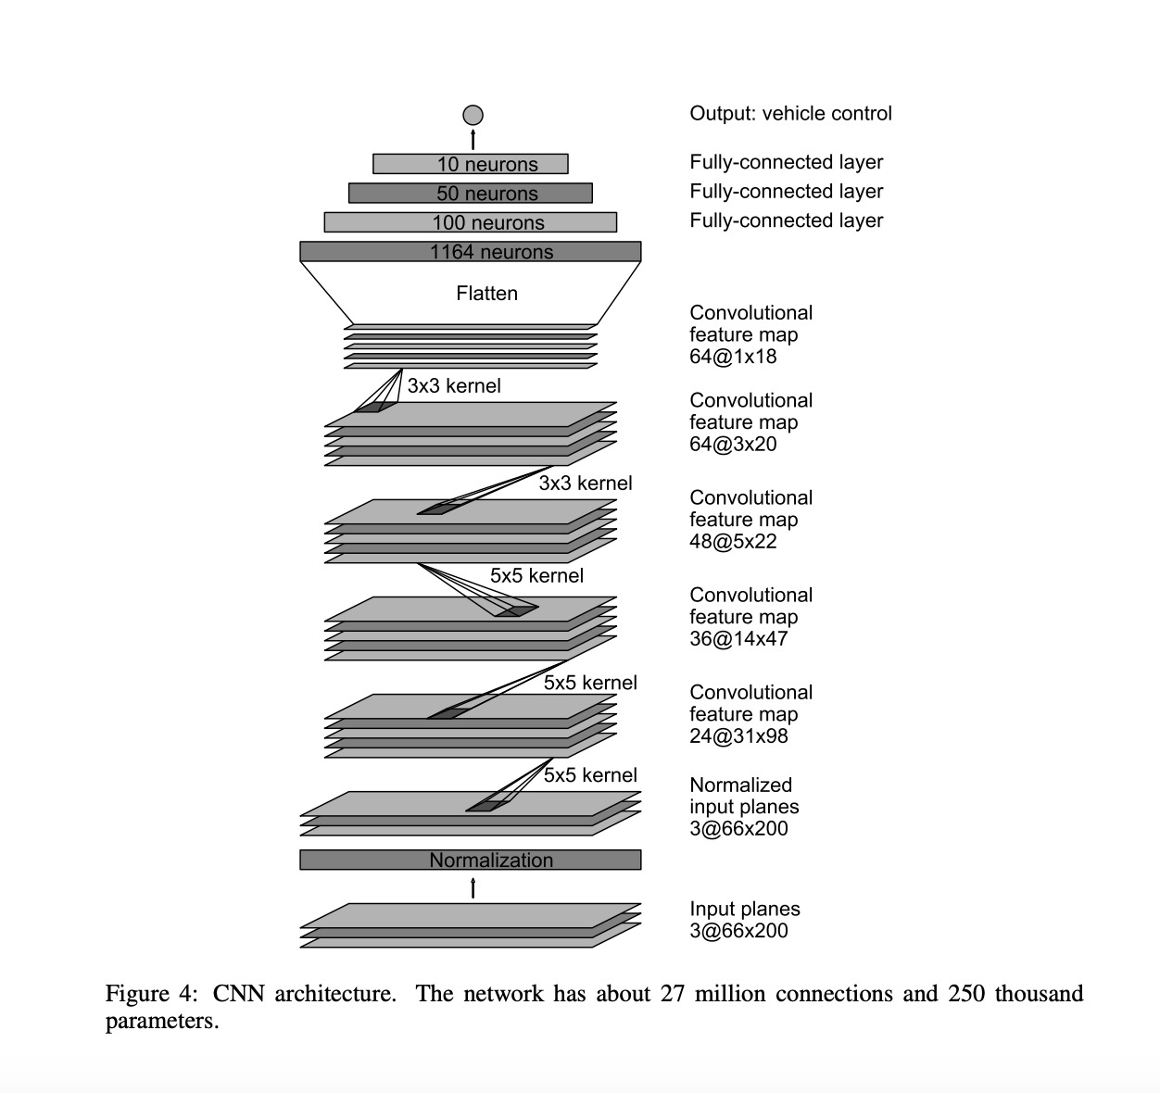
Object Detection Using Machine Learning And AI
Convolutional Neural Network

Slide 8
ADVANTAGES OF SELF- DRIVEN CARS USING AI
AI would have a low error rate compared to humans, if coded properly. They would have incredible precision, accuracy, and speed . They won't be affected by hostile environments, thus able to complete dangerous tasks, explore in space, and endure problems that would injure or kill us .
Replace humans in repetitive, tedious tasks and in many laborious places of work . Predict what a user will type, ask, search, and do.
Interact with humans for entertainment or a task as avatars or robots . An example of this is AI for playing many videogames .
Can simulate medical procedures and give info on side effects . Robotic radio surgery, and other types of surgery in the future, can achieve precision that humans can't. They don't need to sleep, rest, take breaks, or get entertained, as they don't get bored or tired.

Slide 9
THANK YOU

